Slide 1
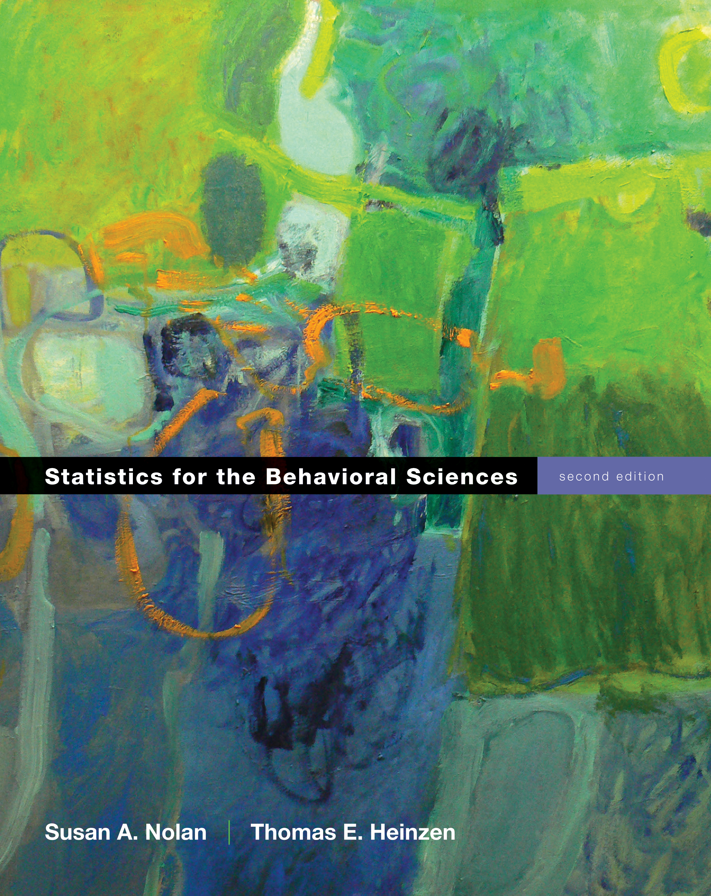
The Paired-Samples t Test
Chapter 10

Slide 2
Research Design Issues
So far, everything we’ve worked with has been one sample
One person = Z score
One sample with population standard deviation = Z test
One sample no population standard deviation = single t-test

Slide 3
Research Design Issues
So what if we want to study either two groups or the same group twice
Between subjects = when people are only in one group or another (can’t be both)
Repeated measures = when people take all the parts of the study

Slide 4
Research Design Issues
Between subjects design = independent t test (chapter 11)
Repeated measures design = dependent t test (chapter 10)

Slide 5
Research Design Issues
So what do you do when people take things multiple times?
Order effects = the order of the levels changes the dependent scores
Weight estimation study
Often also called fatigue effects
What to do?!

Slide 6
Research Design Issues
Counterbalancing
Randomly assigning the order of the levels, so that some people get part 1 first, and some people get part 2 first
Ensures that the order effects cancel each other out

Slide 7
Paired-Samples t Test
Two sample means and a within-groups design
We have two scores for each person … how can we test that?
The major difference in the paired-samples t test is that we must create difference scores for every participant

Slide 8
Paired-Samples t Test
Distributions
Z = Distribution of scores
Z = distribution of means (for samples)
t = distribution of means (for samples with estimated standard deviation)
t = distribution of differences between means (for paired samples with estimated standard deviation)

Slide 9
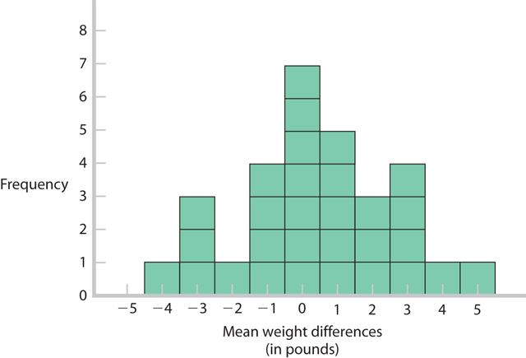
Distribution of Differences Between Means

Slide 10
Distribution of Differences Between Means
So what does that do for us?
Creates a comparison distribution (still talking about t here … remember the comparison distribution is the “population where the null is true”)
Where the difference is centered around zero, therefore um = 0.

Slide 11
Distribution of Differences Between Means
When you have one set of scores by creating a difference score …
You basically are doing a single sample t where um = 0.
Whew! Same steps (very different output).

Slide 12
Assumptions
Assumption | Solution
Normal distribution | N >=30
DV is scale | Nothing – do nonparametrics
Random selection (sampling) | Random assignment (to which counterbalance order! We can do this now!)

Slide 13
Steps for Calculating Paired Sample t Tests
Step 1: Identify the populations (levels), distribution, and assumptions.
Step 2: State the null and research hypotheses.
Step 3: Determine the characteristics of the comparison distribution.
Step 4: Determine critical values, or cutoffs.
Step 5: Calculate the test statistic.
Step 6: Make a decision.

Slide 14
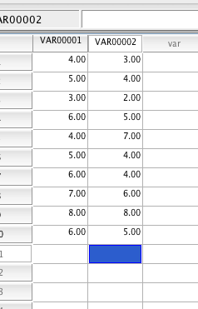
SPSS
Enter data paired – so person 1 level 1 column 1, person 1 level 2 column 2

Slide 15
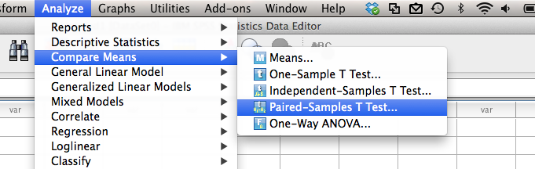
SPSS
Analyze > compare means > paired samples t

Slide 16
SPSS
What to put in first (match your hyp test step ½)?
I always put level 2 minus level 1 because then:
If positive scores then from level 1 to level 2 scores went up
If negative scores then from level 1 to level 2 scores went down

Slide 17
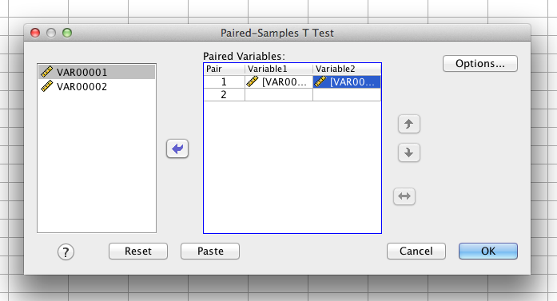
SPSS
Move both scores over

Slide 18
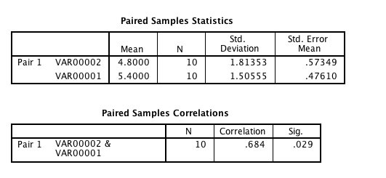
SPSS

Slide 19
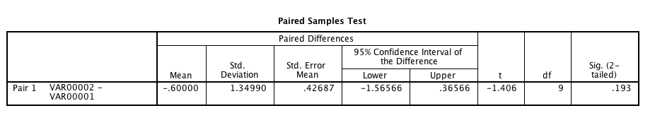
SPSS

Slide 20
Beyond Hypothesis Testing
Just like z tests, single-sample t tests, we can calculated confidence intervals and effect size for paired-samples t tests
Guess what! You get this in the output! Yay!

Slide 21
Steps for Calculating CIs
Step 1. Draw a normal curve with the sample difference between means in the center.
Step 2. Indicate the bounds of the CI on either end, writing the percentages under each segment of the curve.
Step 3. Look up the t values for lower and upper ends of the CIs in the t table.
Step 4. Convert the t values to raw differences.
Step 5. Check the answer.

Slide 22
Effect Size
Cohen’s d:
Note this S = s of the difference scores not s of either level.

Slide 23
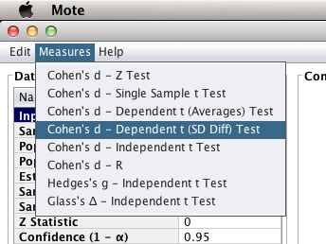
MOTE
Use dependent t (sd diff) – this one matches the mean differences version

Slide 24
MOTE
Be sure to enter at least:
M difference (or level 1 level 2)
SD difference or SE difference (in the t-test box)
N or df
You must enter all 3 to get the right numbers, remember we discussed that it always starts with N = 2 so that it doesn’t crash.

Slide 25
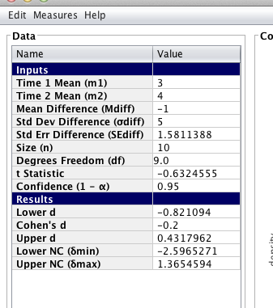
MOTE

